Slide 1
Chapter 11
Design via Frequency Response

Slide 2
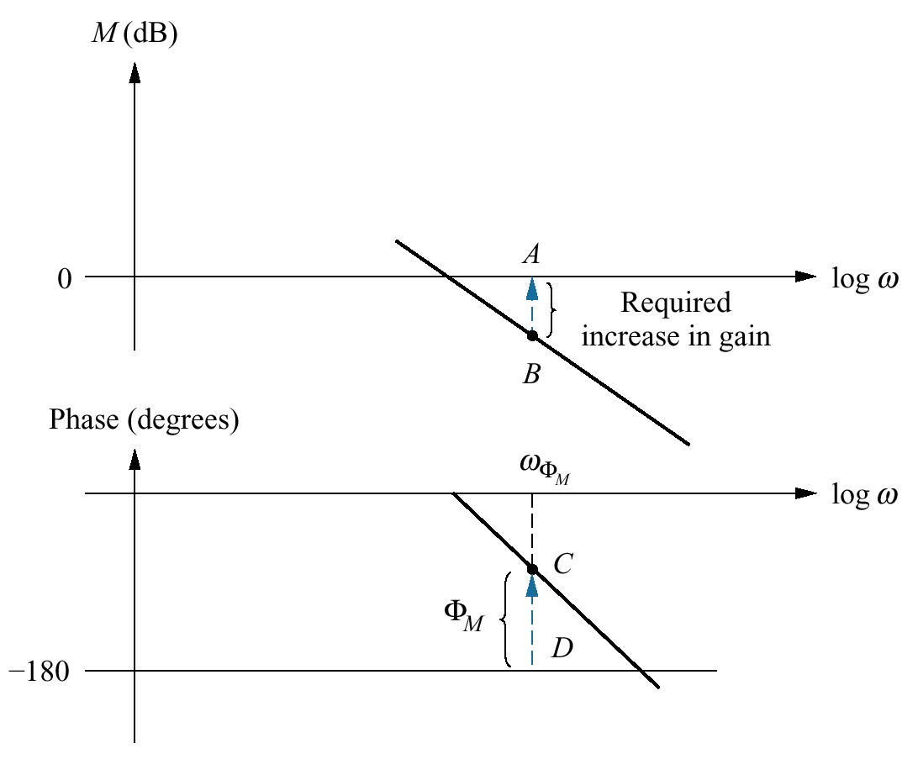
Figure 11.1
Bode plots showing
gain adjustment for a
desired phase margin

Slide 3
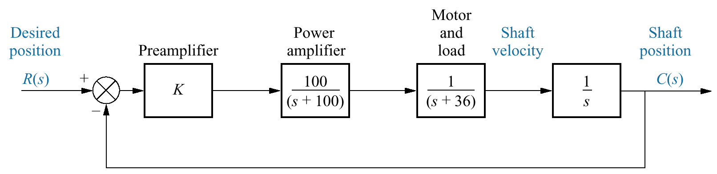
Figure 11.2
System for
Example 11.1

Slide 4
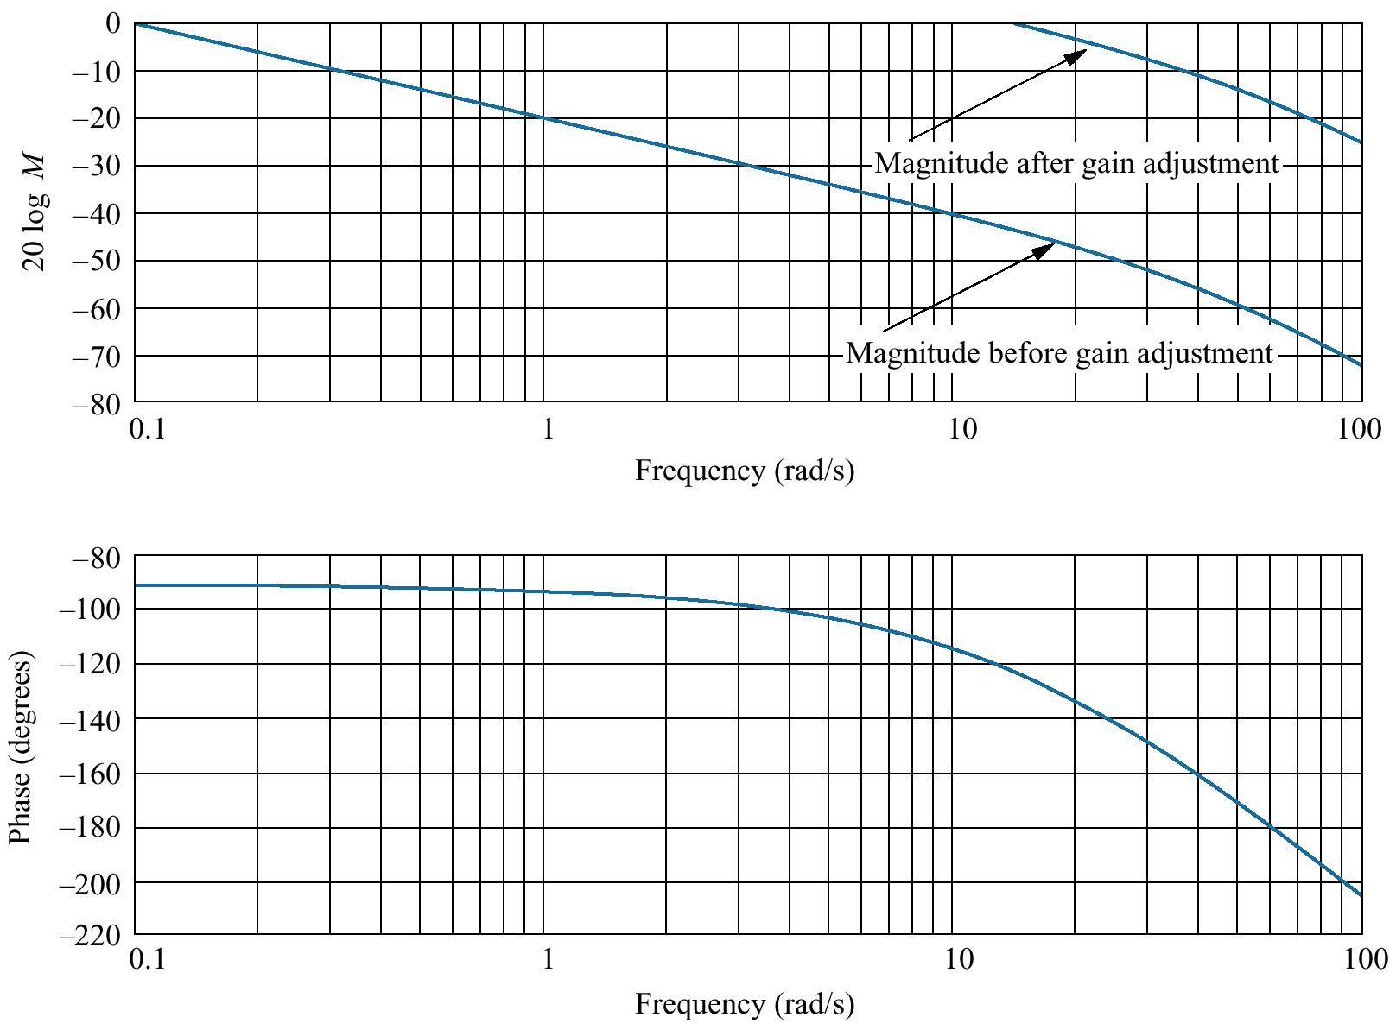
Figure 11.3
Bode magnitude
and phase plots for
Example 11.1

Slide 5
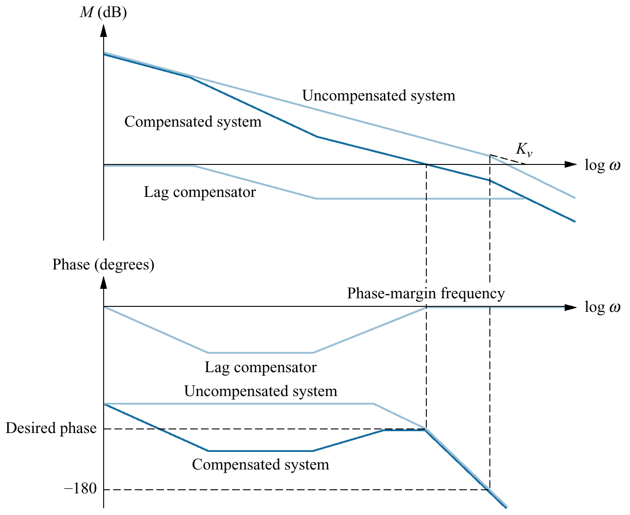
Figure 11.4
Visualizing lag
compensation

Slide 6
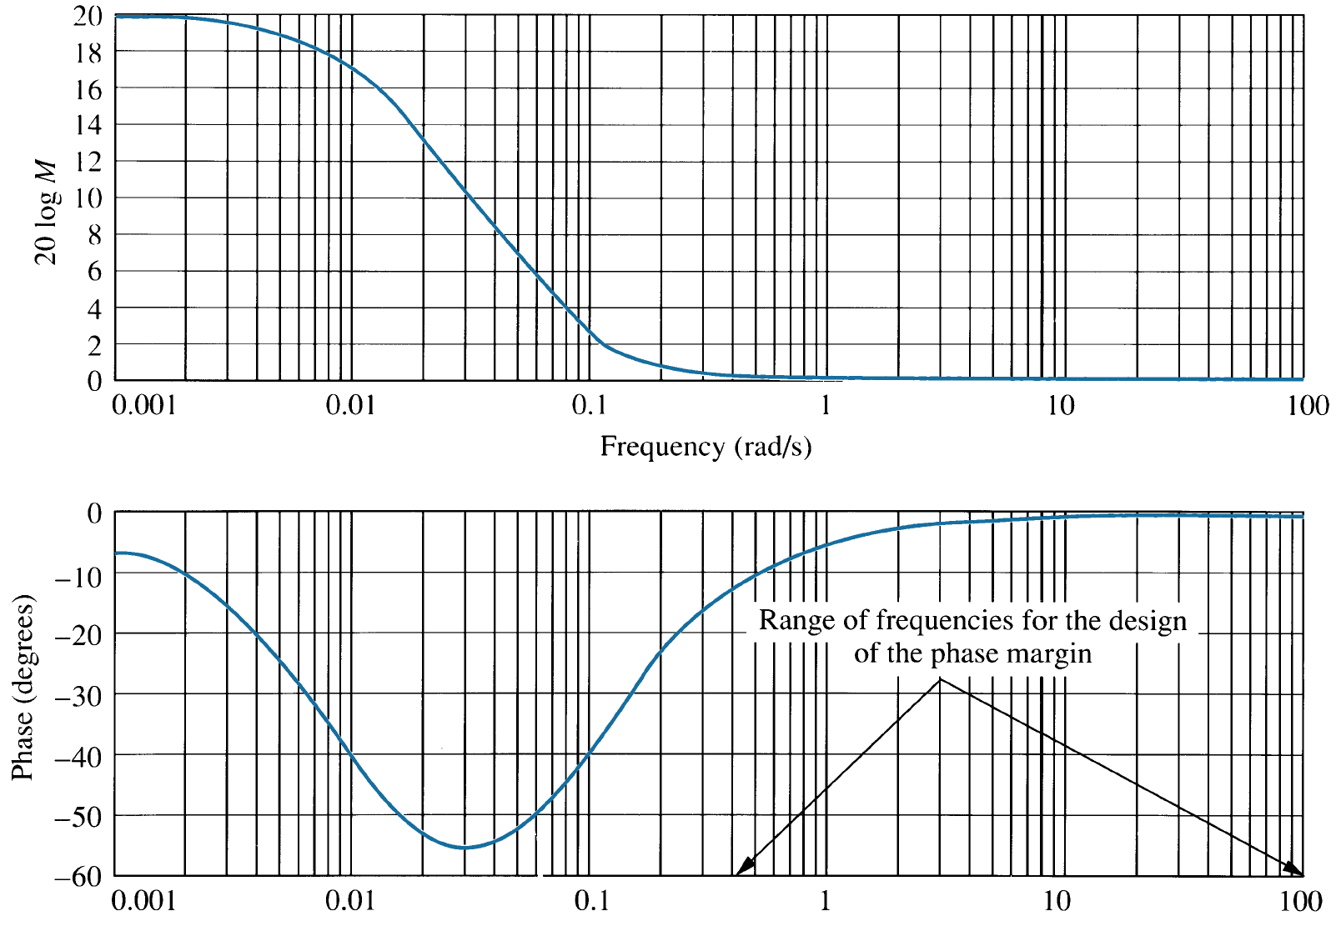



Figure 11.5
Frequency response
plots of a lag compensator,

Slide 7
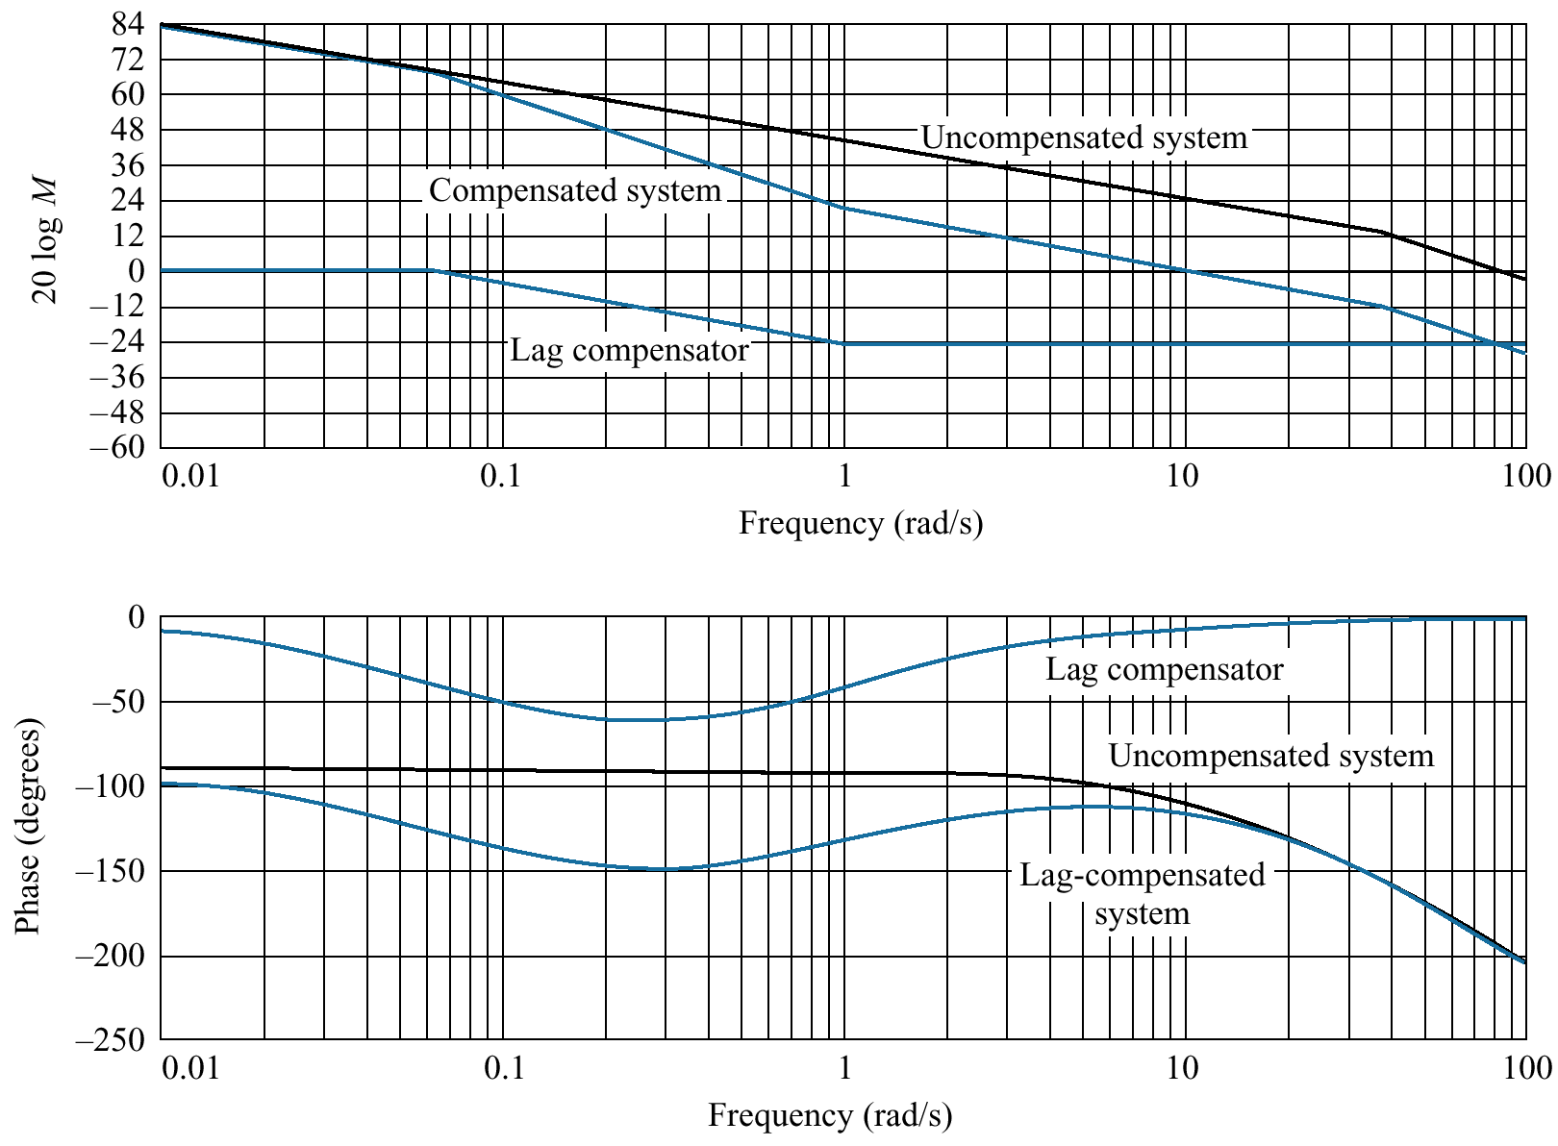
Figure 11.6
Bode plots for
Example 11.2

Slide 8
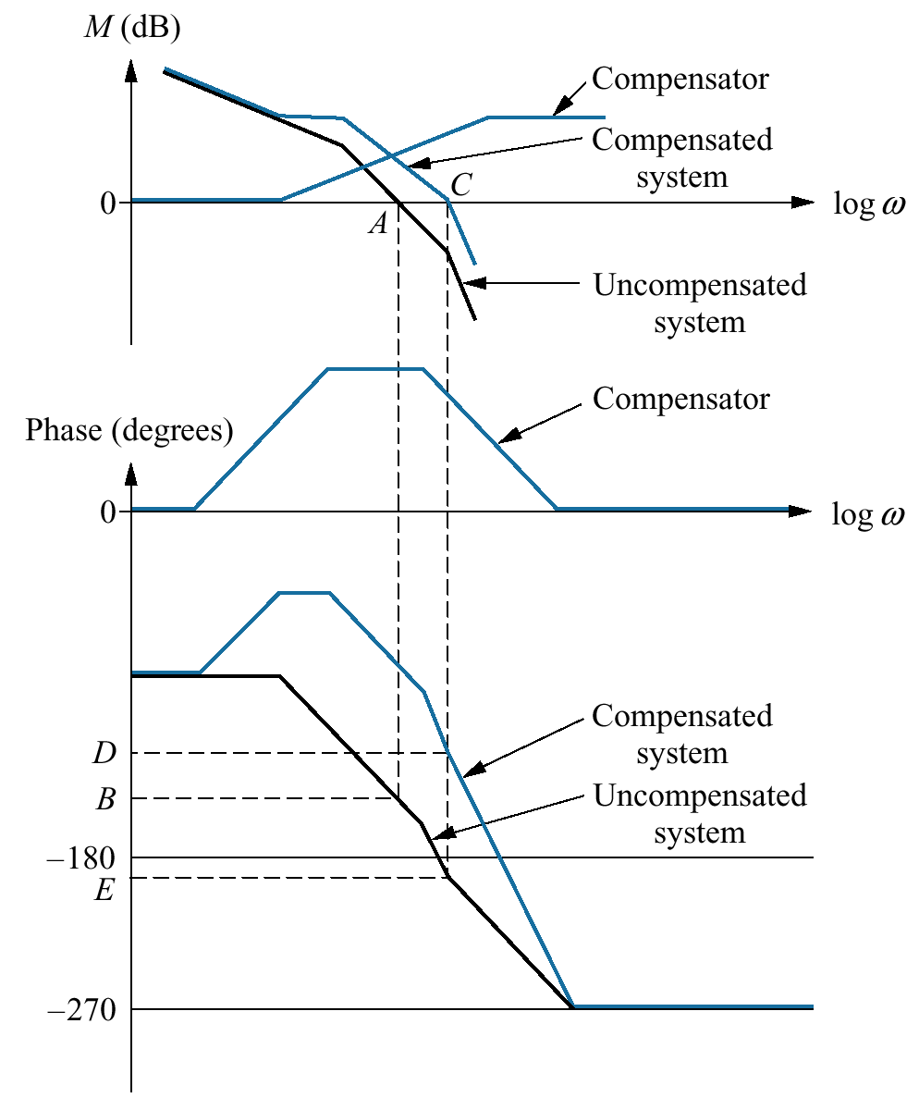
Figure 11.7
Visualizing lead
compensation

Slide 9
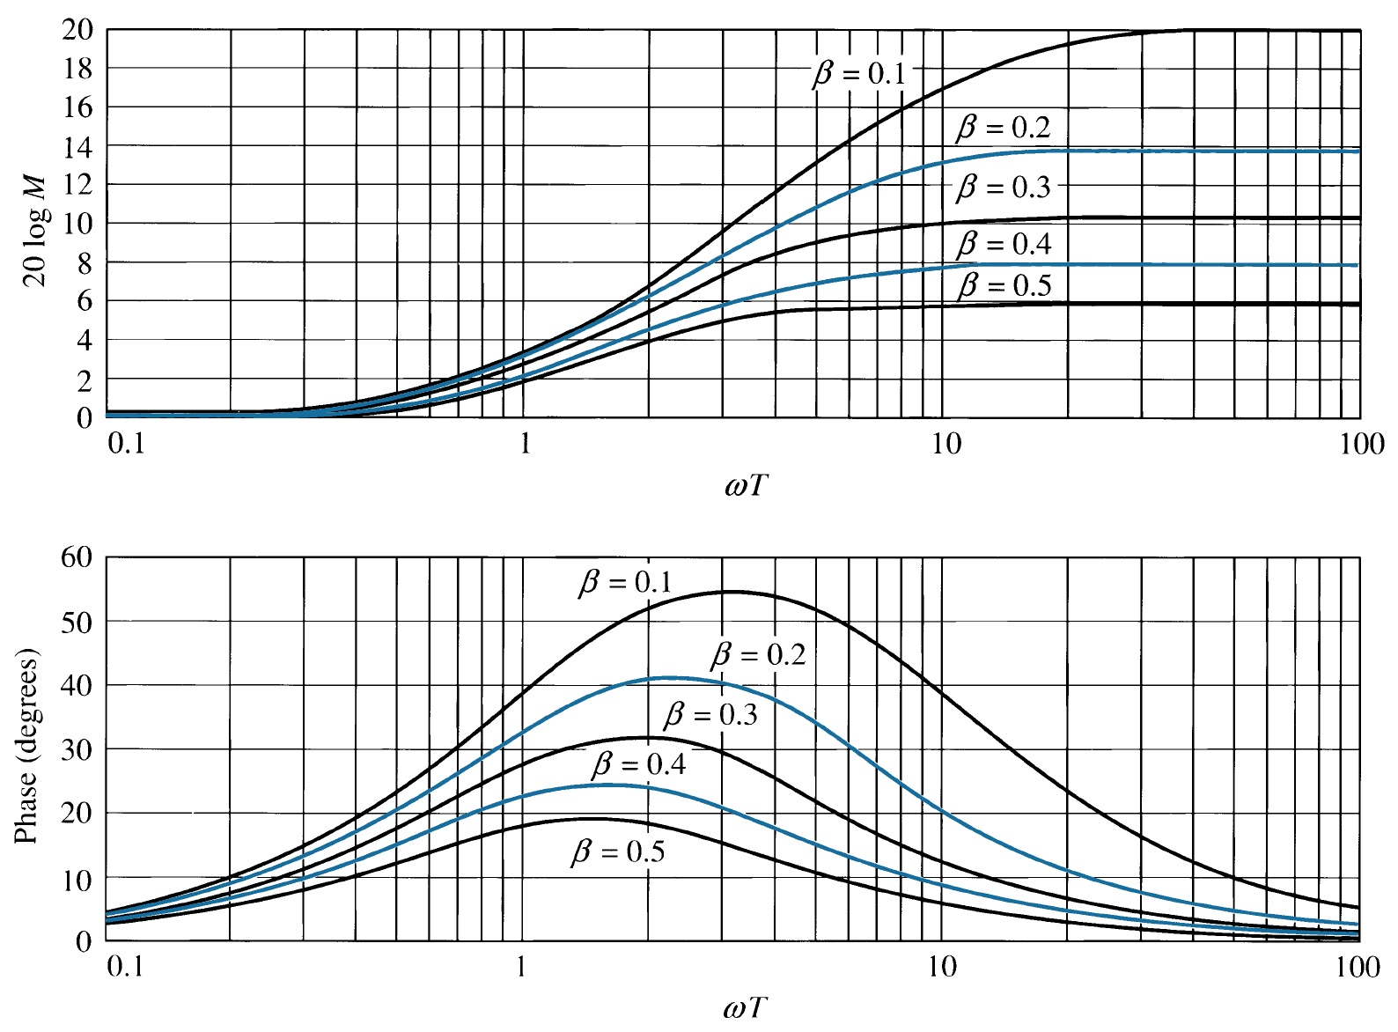
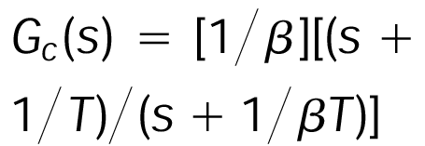
Figure 11.8
Frequency response
of
a lead
compensator,

Slide 10
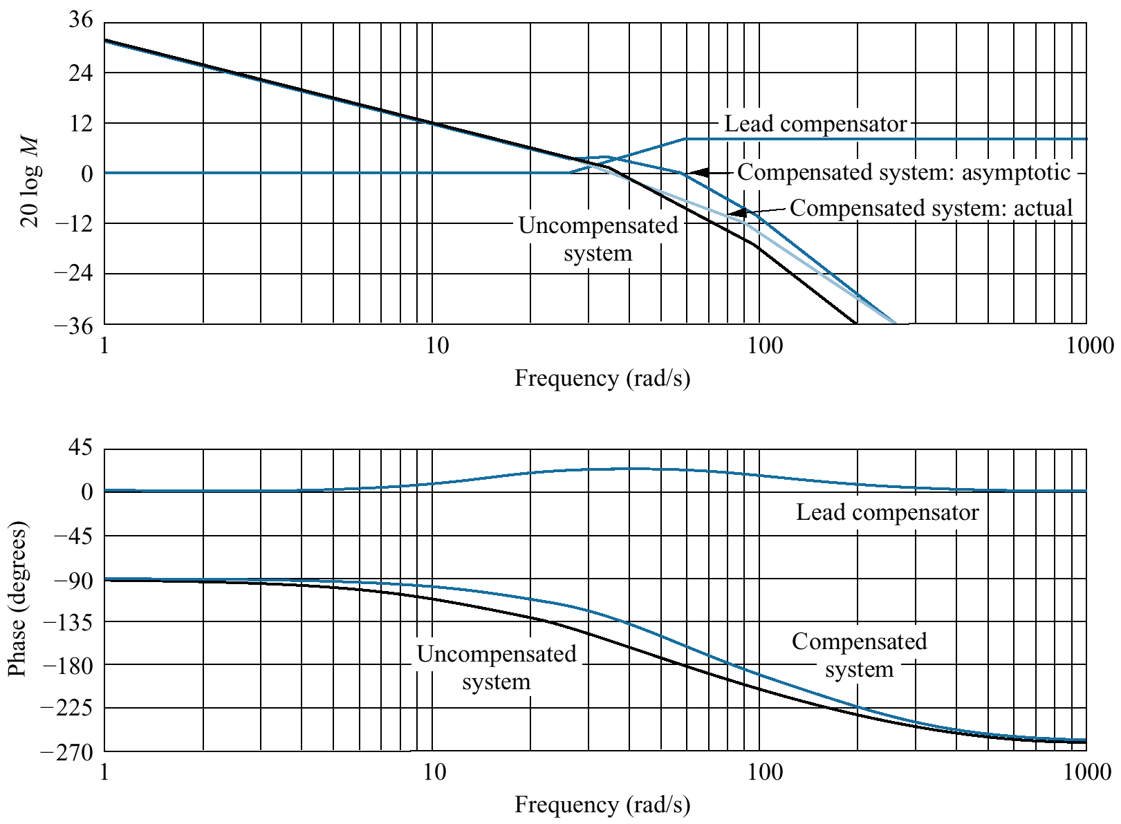
Figure 11.9
Bode plots for lead
compensation in
Example 11.3

Slide 11
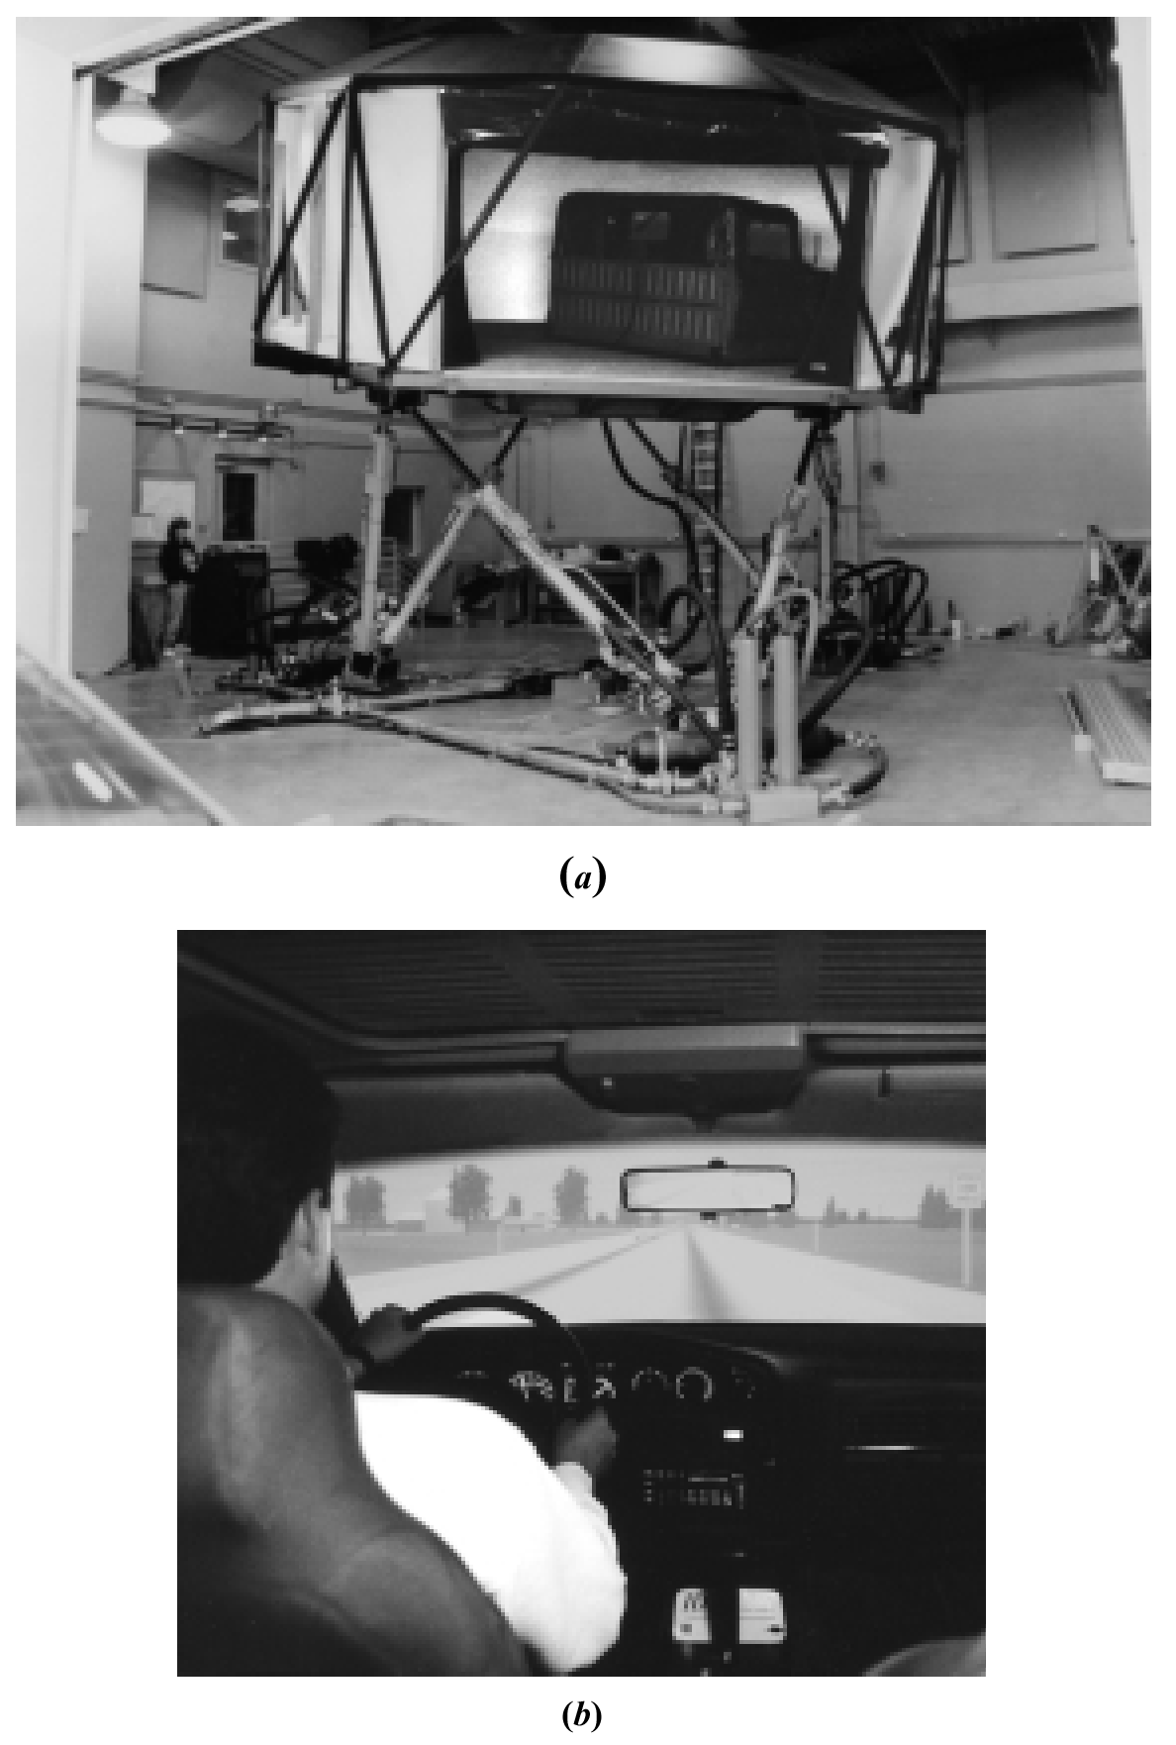
Figure 11.10
a. The Iowa Driving
Simulator;
b. test driving the
simulator with its
realistic graphics

Slide 12
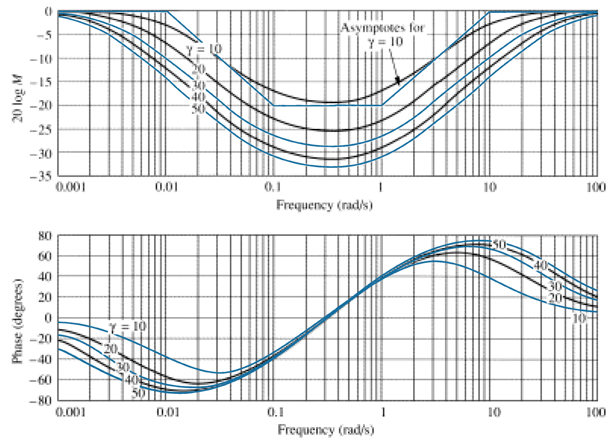
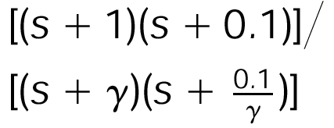
Figure 11.11
Sample frequency
response curves for
a lag-lead compen-
sator, G_{c}(s) =

Slide 13
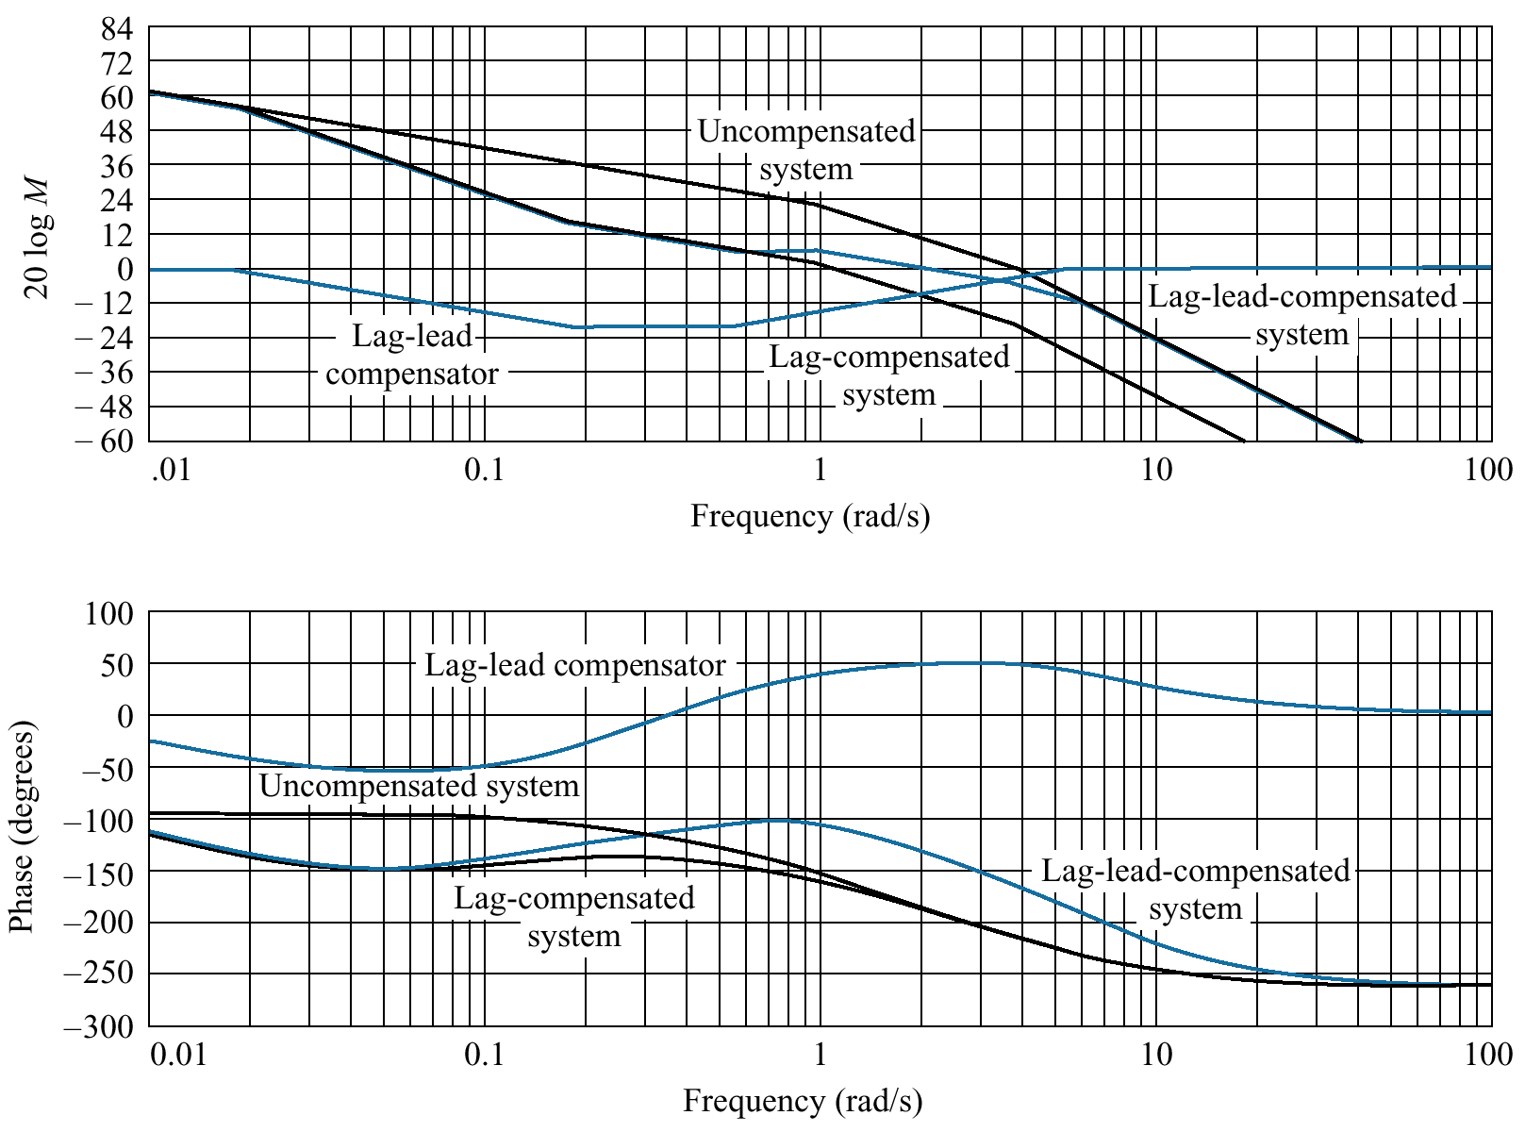
Figure 11.12
Bode plots for lag-
lead compensation in
Example 11.4

Slide 14
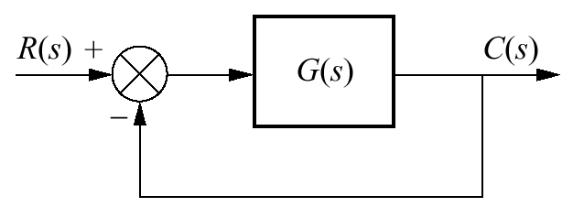
Figure P11.1

Slide 15
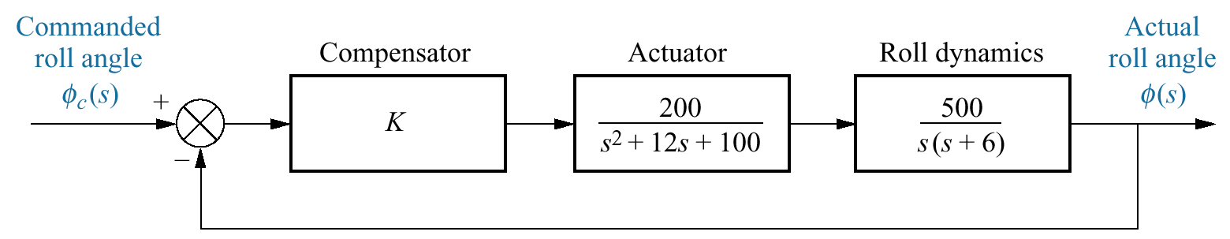
Figure P11.2
Towed-vehicle roll
control

Slide 16
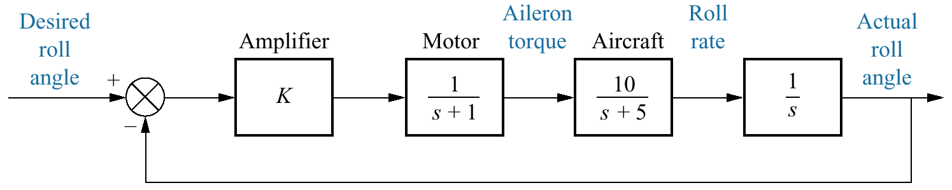
Figure P11.3

Slide 17
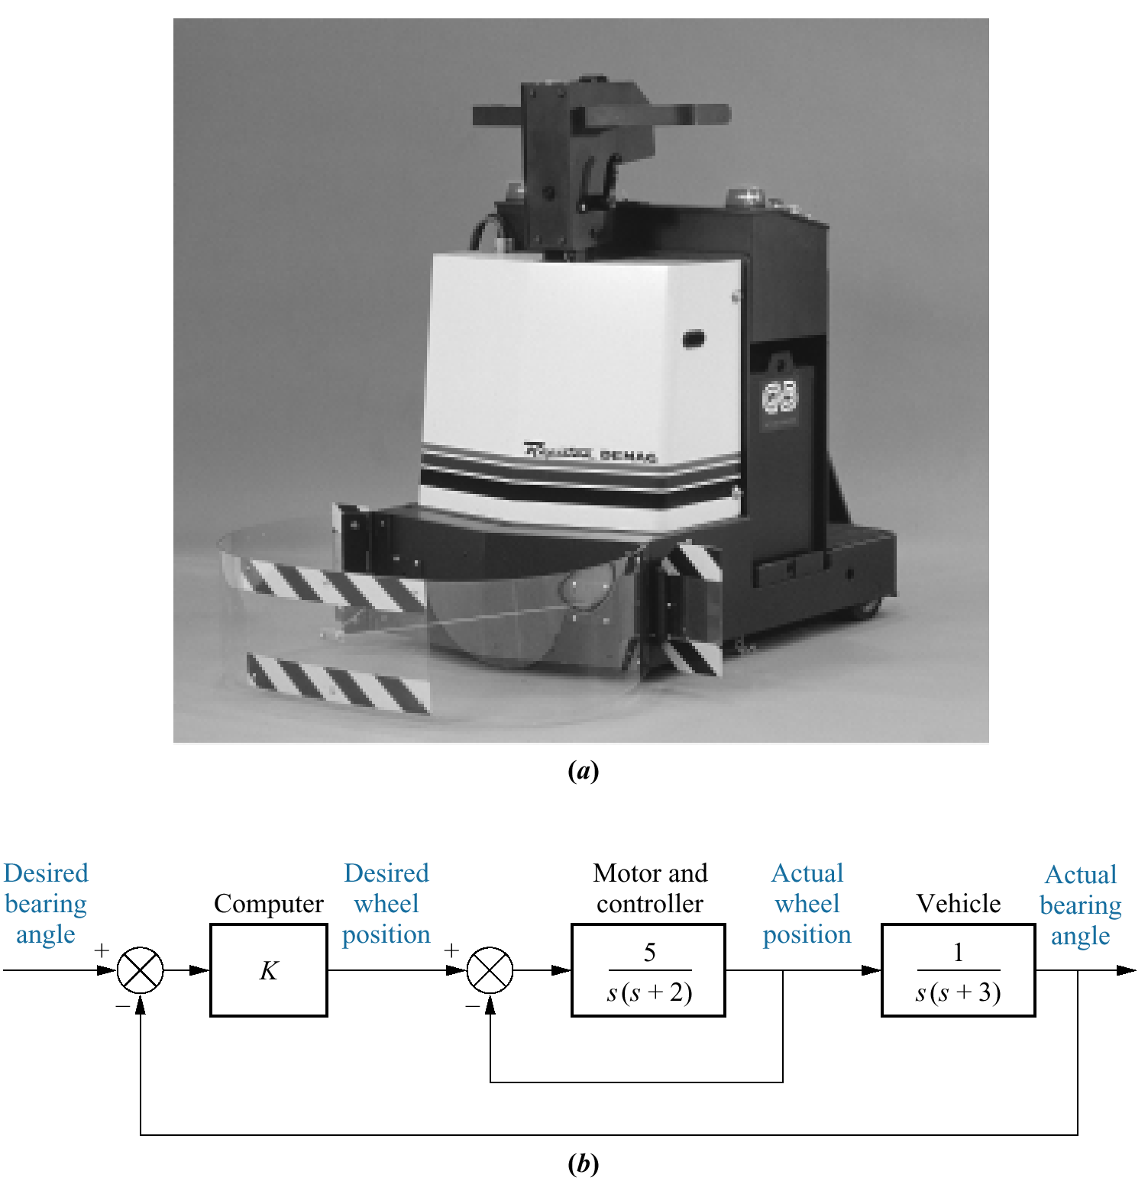
Figure P11.4
a. A self-guided
vehicle;
b. simplified block
diagram

Slide 18
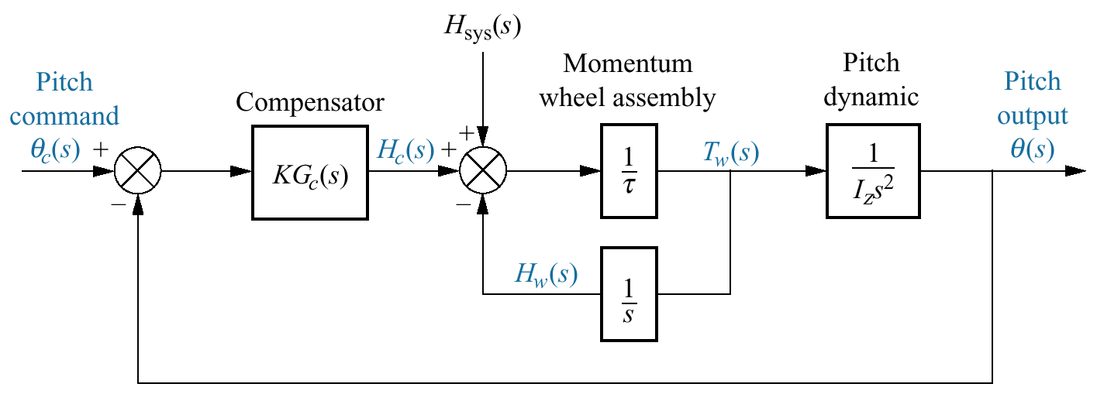
Figure P11.5

